Slide 1


KAKATIYA UNIVERSITY COLLEGE OF ENGINEERING AND TECHNOLOGY
DEPARTMENT OF
ELECTRONICS AND COMMUNICATION ENGINEERING
A MINI PROJECT
ON
CONTROLLING RGB-LED STRIP THROUGH AN ANDRIOD APP
By E. SAIKIRAN
215671552L

Slide 2
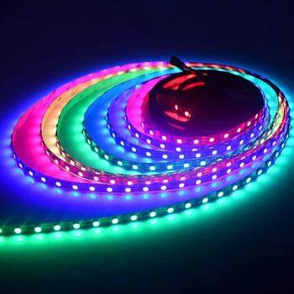
ABSTRACT
RGB LED strip can be controlled and obtain desired outputs by interfacing it to an android device or any controlling device like Arduino, Wi-Fi module
The tricolor LEDS have amazing feature that it can generate any color with delays or no delay. This helps to make an attractive lighting.
In general, the LED strips are operated on predefined code, we cannot alter the code. It results routine play of LEDS and colors. The variation of color is possible by changing the voltages at the 3 terminals accordingly except common lead.
Nowadays, we already have similar applications but couldn’t change the color of LEDs instantaneously and the transition time too.
This project helps us to do so.
This has a wide applications in commercial purposes like shopping malls, Modern ceiling, Music, Arts exhibition.
KUCET-ECE

Slide 3
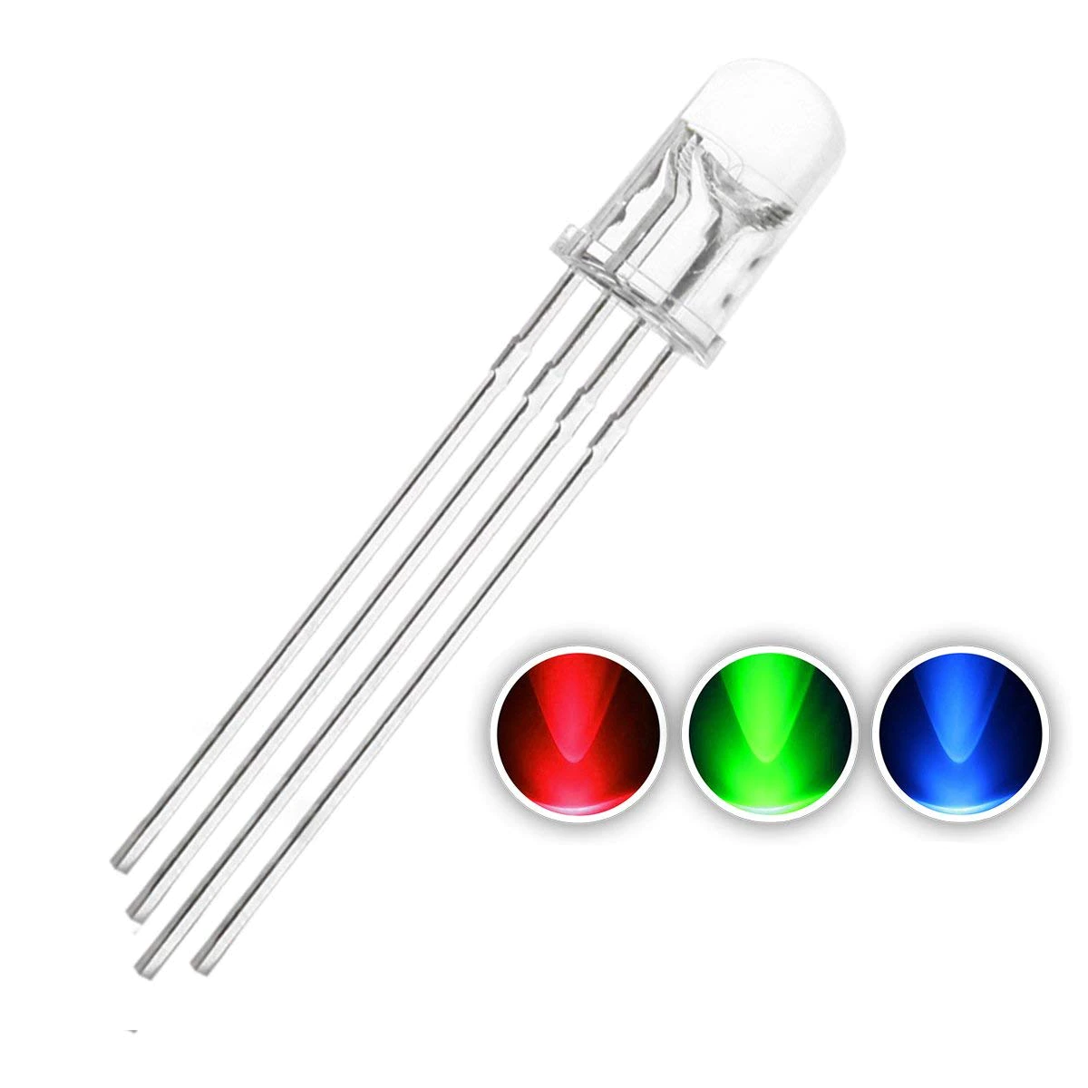

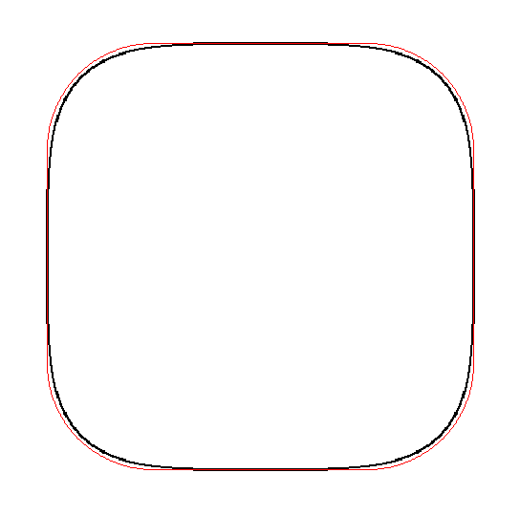
Existing LED STRIP
Proposing LED STRIP
Can display variety of colors, predefined code
Colors varying at the time of displaying
Changing the pattern of LED displaying
Instantaneous operation with mobile
Wide Applications and commercial use
Screens, shopping malls
KUCET-ECE

Slide 4
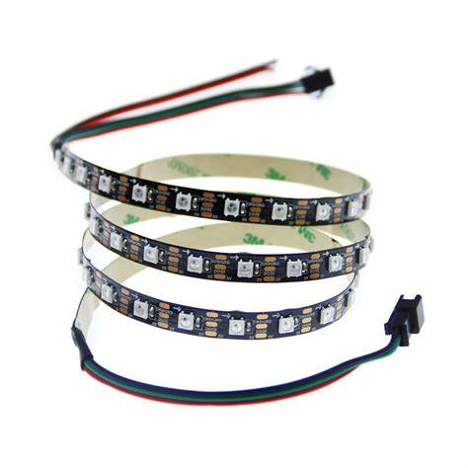
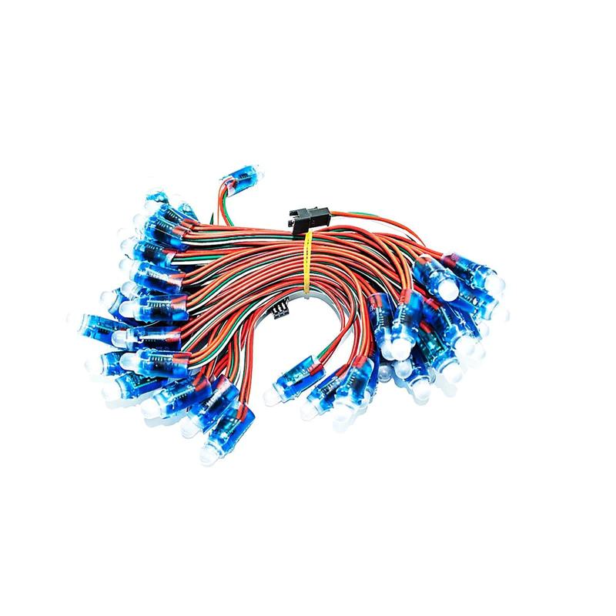
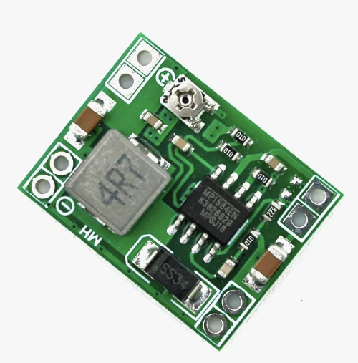
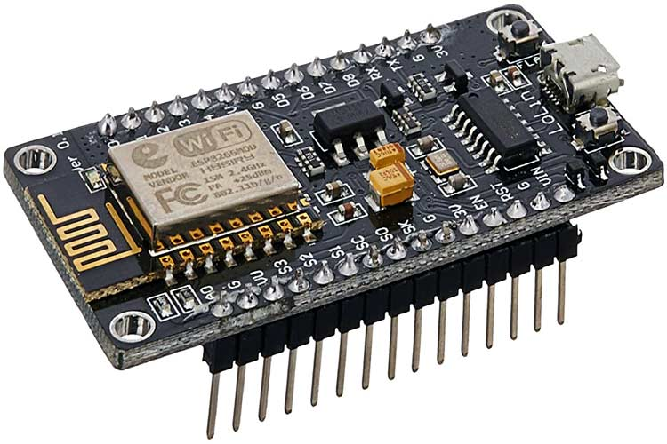
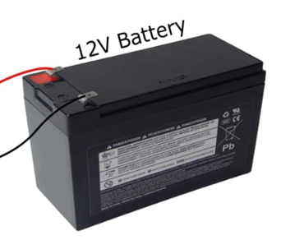
COMPONENTS USED:
Software required:
1.LED STRIP(WS2811/WS2812B)
3.BUCK CONVERTER
Arduino IDE 1.8.18 with library file #include<FastLED.h>
#include<ESP8266WiFi.h>
Wi-Fi pixel LED app
WS2812B
WS2811B
2.NODMCU[ESP8266]
4.12V BATTERY
KUCET-ECE

Slide 5
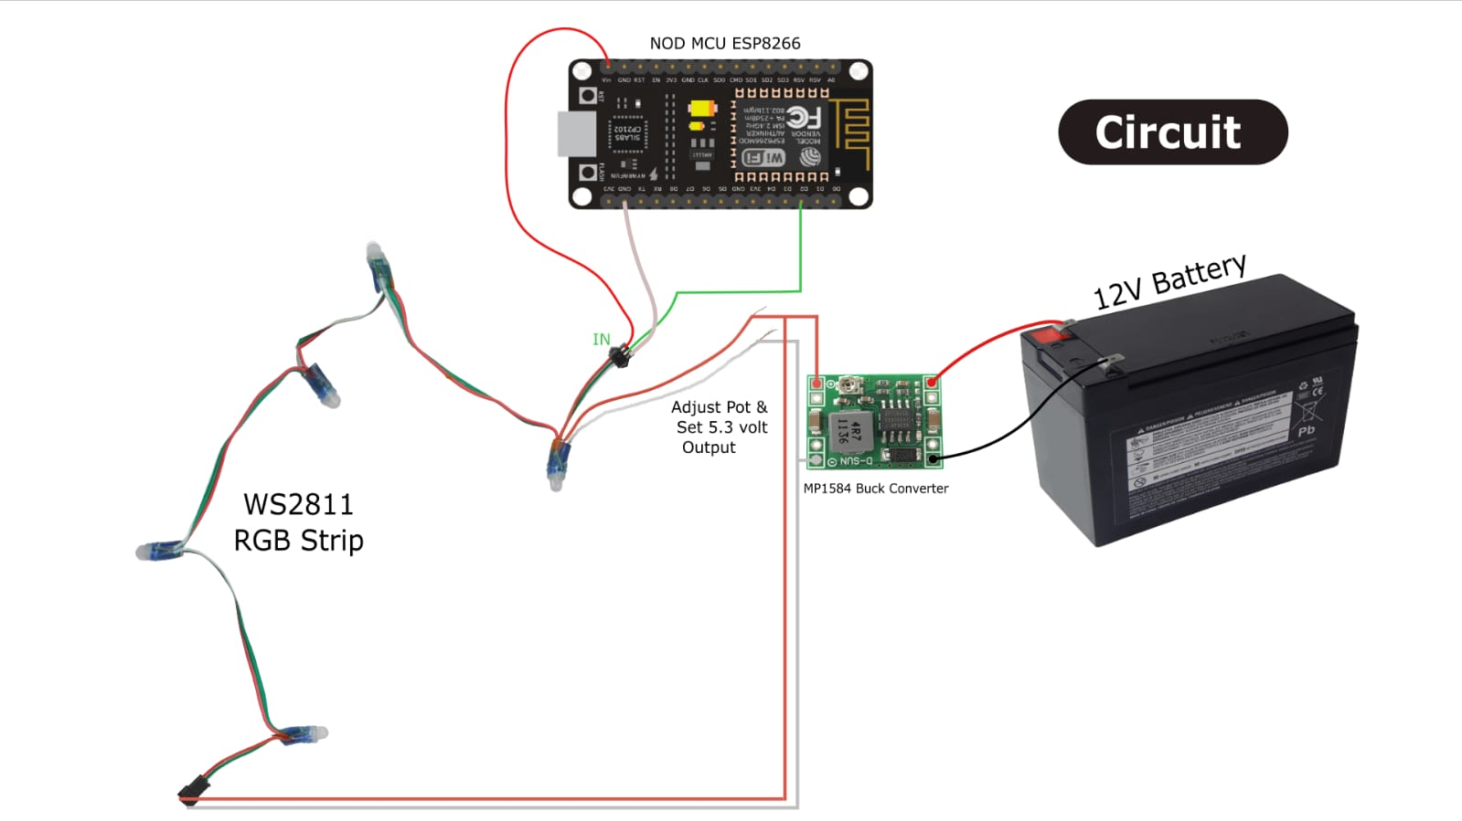
KUCET-ECE

Slide 6
Flow diagram
Connect LED strip to buck converter
Type the code in Arduino IDE
By including the library files #include<FastLED.h>
#include<ESP8266WiFi.h>
Dump the code into Node MCU
Give the Wi-Fi network ID and password to connect (in the Code)
We obtain a IP address in the code that we should paste it into app to interface with circuit
App has it’s own UI which enables controlling of colors, alter pattern of displaying LEDS

Slide 7
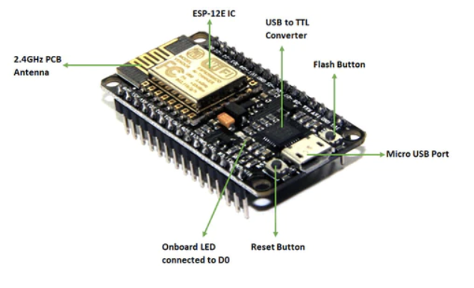
Component description:
WS2812B features:
4-7V DC, 5V Recommended Supply voltage
120 degrees viewing angle.
Red: (620-630nm) @ 550-700mcd
Green: (515-530nm) @ 1100-1400mcd
Blue: (465-475nm) @ 200-400mcd
256 brightness levels for each pixel of three primary colours.
NODE MCU SPECIFICATIONS:
Microcontroller: Tensilica 32-bit RISC CPU Xtensa LX106
Operating Voltage: 3.3V
Input Voltage: 7-12V
Digital I/O Pins (DIO): 16
Analog Input Pins (ADC): 1
UARTs: 1
SPIs: 1
I2Cs: 1
Flash Memory: 4 MB
SRAM: 64 KB
Clock Speed: 80 MHz
KUCET-ECE

Slide 8
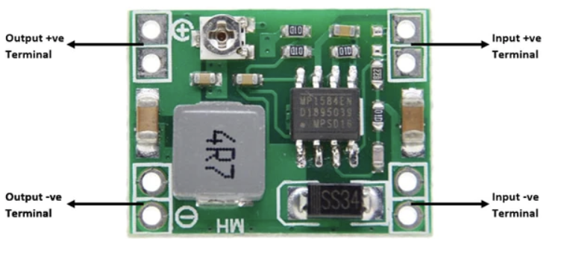
BUCK CONVERTER
Stepdown DC to DC Converter
Specifications
Module Properties: non-isolated constant voltage module
Rectification: non-synchronous rectification
Input voltage: 4.5V-28V
Output Voltage (Less than input): 1.0V-20V
Output current: 3A maximum
Conversion efficiency: 92% (maximum)
Switching frequency: 1MHz
KUCET-ECE

Slide 9
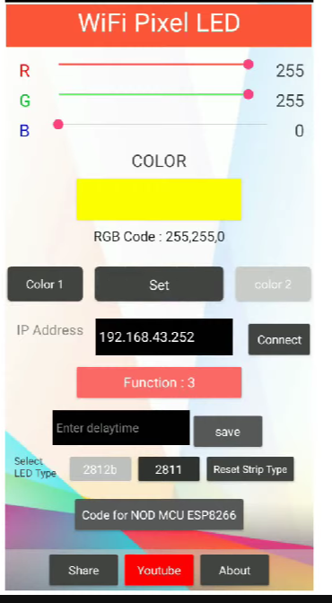
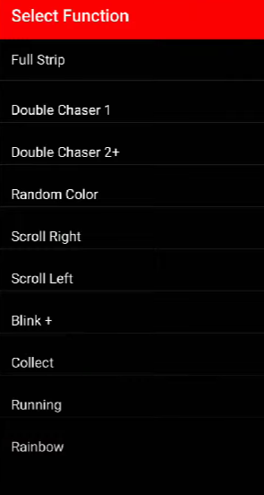
App description
By varying the R,G,B values we can produce any colour ,the produced color is shown below int app
We can select dual colors by given options, shown in figure 1
We can choose pattern of blinking lights choosing options in given picture 2
Pre existing Functions :
Full strip
Double chaser1
Double chaser 2+
Random color
Scroll right
Blink+
Collect
Running
Rainbow
KUCET-ECE

Slide 10
ADVANTAGES
Adjustable
Flexible
Best Colour Variety
Super Thin
Easy To Install
Dimmable Lighting
Safe
Custom
Lower Cost Of Ownership
Less likely to overheat
Ambient lighting
Illuminate furniture
Indoor light strips(ceiling)
Staircase lighting
KUCET-ECE

Slide 11
APPLICATIONS :
Decorative Lighting
LED lighting for special purposes
Irregular LED display
Notification Board
LED based notification display
Cascaded lighting
KUCET-ECE

Slide 12
Disadvantages
Skilled person required for modifying the code
Arduino IDE need to installed for further modification of code
KUCET-ECE

Slide 13
Summary and future scope:
The project has wide applications and flexible. So we can use this simple technology in modern architecture designing. Its gives new finishing Illumination to furniture, Interior designing, Saloons, photography, Parties with colorful decorations, light decoration gives great vibes to big events.
These can be used as notification boards, sign boards, public transport
Used in public areas like shopping malls, airports, Bus stations, railway stations seaports, ships
KUCET-ECE

Slide 14
REFERENCES:
ScitiveX https://youtu.be/7UKh2KQTjUk
Arduino reference
Quartz components for detail description
Thank you
KUCET-ECE

